Slide 1
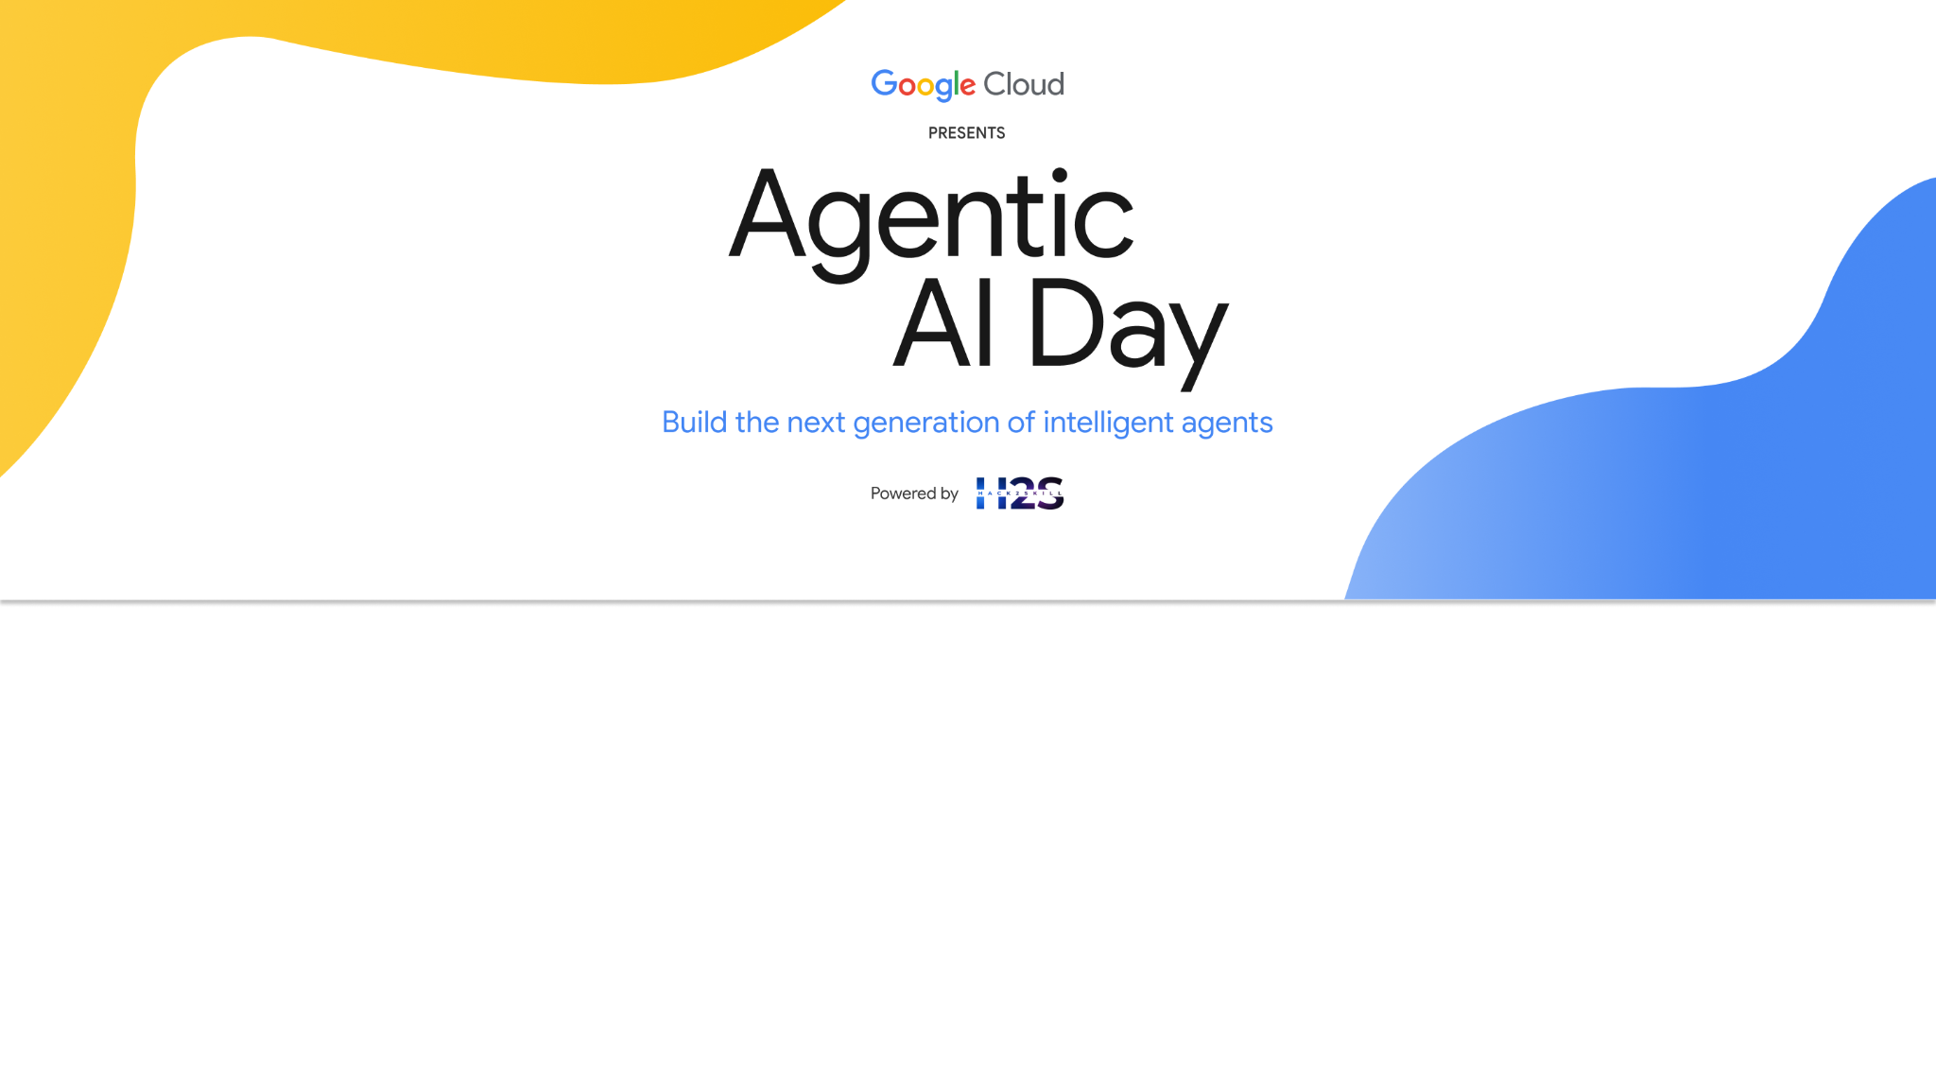
Team Details
Team name: Gradient Rebels
Team leader name: Mohammad Tarique Anjum
Problem statement: Let AI Speak to Your Money

Slide 2
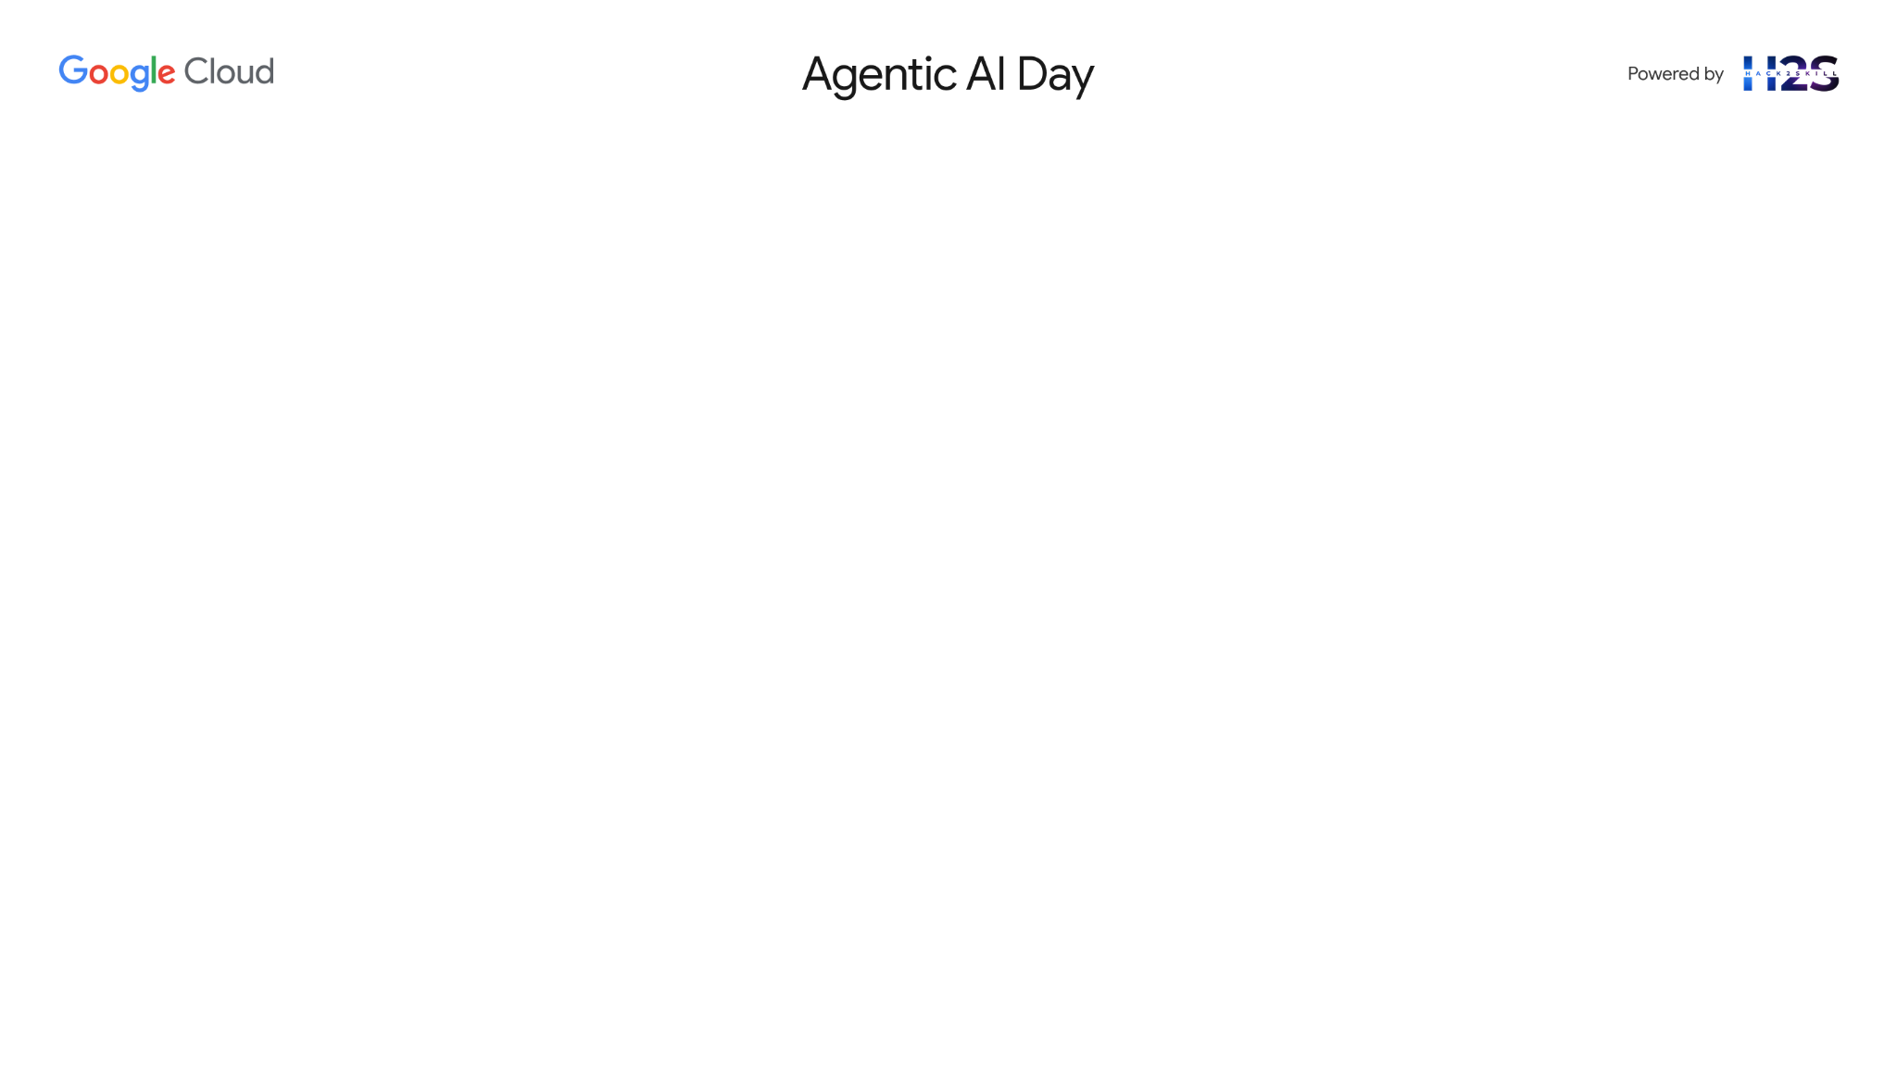
Brief about the idea : Wealth Whisperer – Your Personal AI Investment Agent
Wealth Whisperer is a revolutionary AI-powered financial advisor designed to proactively and intelligently manage your personal investments. Unlike traditional wealth management apps that simply display financial information or generic insights, Wealth Whisperer actively evaluates your financial health, monitors real-time market conditions, analyzes news and sentiment, and aligns all these insights with your unique financial goals and risk tolerance.
It doesn't just recommend—it acts. Using seamless integration with the Fi Multi-Channel Payment (Fi MCP) ecosystem, the agent can instantly execute fund reallocations, smartly investing idle funds and optimizing your financial portfolio in real-time.

Slide 3
Opportunities
How different is it from any of the other existing ideas?
Platform | Passive Dashboards | Smart Reallocation | Personalized Advice | News-Driven | MCP Integration
Groww / Zerodha | ✅ | ❌ | ❌ | ❌ | ❌
Kuvera | ✅ | ❌ | Somewhat | ❌ | ❌
INDMoney | ✅ | ❌ | ❌ | ❌ | ❌
Wealth Whisperer | ✅ | ✅ | ✅ | ✅ | ✅
Example: “If Nifty drops 2%, most apps just display it. Wealth Whisperer alerts the user, explains the market trend in simple terms, recommends a safe Gilt move, provides a Mint article, and executes the transfer with one tap.”

Slide 4
Opportunities
How will it be able to solve the problem?
Eliminates Inaction & Overwhelm: Most users don’t invest or reallocate funds due to fear, lack of knowledge, or decision fatigue. → Wealth Whisperer offers ready-to-act, low-friction suggestions, eliminating guesswork.
Reduces Idle Cash & Missed Opportunities: Idle money in savings loses value over time. → The agent monitors balances and automatically recommends short-term, goal-aligned investments (e.g., debt or gilt funds).
Bridges the Financial Literacy Gap: Many users don’t understand when or why to move money. → The agent uses news-backed explanations and plain-language rationale to educate while acting.
Aligns Daily Behavior with Long-Term Goals: Users often overspend or pause SIPs without realizing the long-term impact. → The system tracks goal progress and nudges users when habits derail financial plans.
Provides 24/7 Intelligent Support: Most wealth advisors aren’t accessible in real-time. → Wealth Whisperer is an always-on AI agent—giving timely advice as markets or user contexts shift.

Slide 5
Opportunities
USP of the proposed solution
Proactive, Agentic AI Not just an advisor—it’s an autonomous agent that thinks, explains, and acts based on your financial goals, risk profile, and market changes.
Personalized, Goal-Aligned Investing Every suggestion is deeply tailored to your lifestyle goals (e.g., “Europe 2026” or “Emergency Fund”)—not generic fund tips.
News-Backed, Explainable Recommendations Every action is supported by real-time news and market sentiment, explained in plain language so users trust and understand every move.
Instant Execution via Fi MCP With one tap, the agent executes investments or fund reallocations in real-time—eliminating friction and manual steps.
Transparent, Zero-Commission Guidance No hidden agendas, no product pushing—just unbiased, fiduciary-like advice, focused on what's best for the user.
Always-On Companion Available 24/7 to monitor, suggest, and act—even when you’re offline or distracted.

Slide 6
List of features offered by the solution
1. Smart Monitoring & Insights
Real-time tracking of market trends, Nifty movements, and sentiment
Continuous assessment of user financial behavior and spending patterns
Detection of idle funds and missed investment opportunities
2. Personalized Recommendations
Goal-based, risk-aligned fund suggestions (e.g., SIP, Gilt, Debt)
Proactive rebalancing based on market conditions
Contextual financial advice (e.g., “Consider shifting funds during volatility”)
3, News-Backed Explanations
Curated articles from trusted financial sources (Mint, MoneyControl, etc.)
Summarized insights using LLMs to explain complex topics simply
Justification for every recommendation—builds user trust
4. Instant Execution via Fi MCP
One-tap approval for fund reallocation or investment
Smart rules (e.g., auto-transfer idle cash if above ₹X threshold)
Seamless integration with Fi for real-time fund movement
5. Intelligent Nudges & Alerts
Friendly reminders for paused SIPs or underfunded goals
Gentle nudges based on life events (“Want to boost your Diwali savings?”)
Budget deviation alerts with suggestions
5. Goal Tracking & Visual Progress
Create, view, and modify multiple financial goals
Track monthly contribution, growth, and target completion rate
Get rewarded with motivational nudges and insights
6. Security & Transparency
No commission-based advice—fully user-centric
Encrypted API communication with Fi MCP and storage systems
Privacy-focused: data stored securely with user control

Slide 7
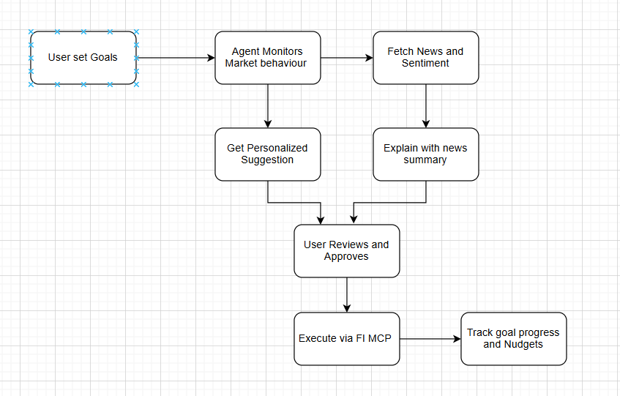
Process flow diagram or use-case diagram

Slide 8
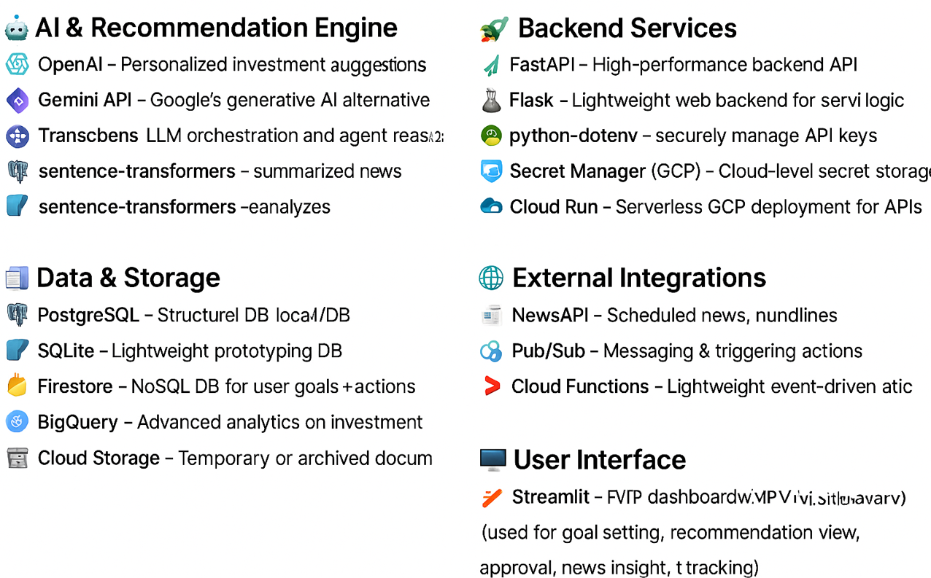
Technologies to be used in the solution

Slide 9
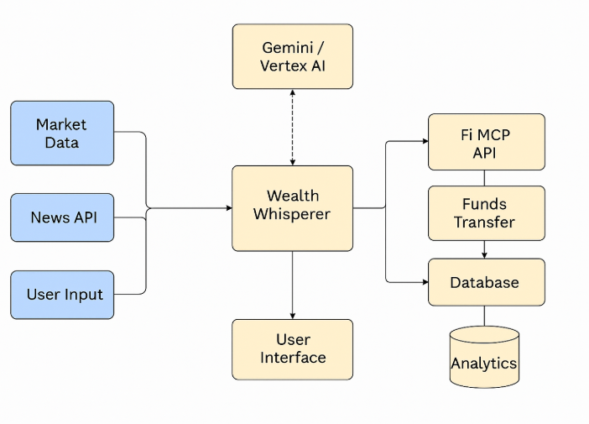
Architecture diagram of the proposed solution

Slide 10
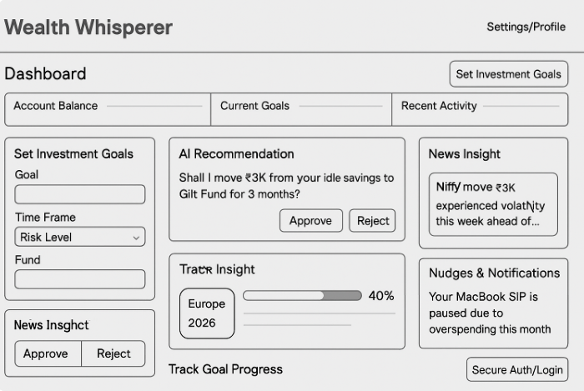
Wireframes/Mock diagrams of the proposed solution (optional)

Slide 11
